Slide 1

Welcome!
In this experiment, you will be performing an orientation matching task. On every trial, you will be briefly presented with two patches of orientation and a checkerboard (like below) overlaid on top of two objects.
Your task is to report whether the two orientations match, while ignoring the checkerboard.
There will be 4 blocks of trials. Each block has 80 trials and the entire experiment will last approximately 30 minutes. You will be able to take breaks in between blocks. There will also be a brief survey immediately following the experiment.

Slide 2
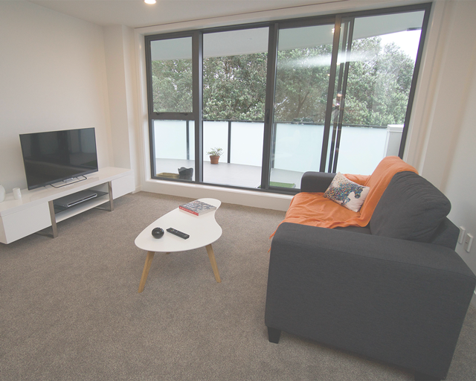
+
+
+
Display 1
Display 1: Fixation
A fixation cross will appear in the middle of the screen, indicating the start of a new trial
No response is necessary, please keep your eyes fixated on the cross

Slide 3
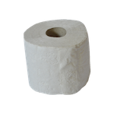
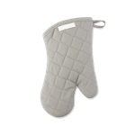
+
+
+
+
+
+
Display 1
Display 3
Display 2
Display 2: Scene
A scene image will appear in the middle of the screen
No response is needed and keep maintaining fixation on the cross

Slide 4
+
+
+
+
+
+
Display 2
Display 4
Display 3
Display 3: Objects
Two objects will appear on either side of the fixation
No response is needed and keep maintaining fixation

Slide 5
+
+
+
+
+
+
Display 3
Display 5
Display 4
Distractor
Two targets
Display 4: Targets
Two target orientations with slanted lines will briefly appear, one in the center and the other on one of the objects
Your task is to indicate whether the two orientations match
The above is an example of when the orientations match
Ignore the checkerboard distractor
The orientations are only flashed for a very short time, so pay attention!

Slide 6
+
+
+
+
Display 4
Display 5
Display 5: Objects & Scene
Since the targets only appear briefly, try to remember whether the orientations match or not
If the two match, press the f key
If the two do not match, press the j key
If you did not see the orientations, take your best guess

Slide 7
+
+
+
+
+
+
+
+
+
Display 1
Display 2
Display 3
Display 4
Display 5
Experiment Sequence
A quick recap. This is the experiment sequence. Maintain fixation on the cross throughout the experiment and report whether the two orientations match or do not match.
If the two are the same orientation, press the f key.
If the two are different orientations, press the j key.
On incorrect trials, the fixation will briefly turn red.

Slide 8
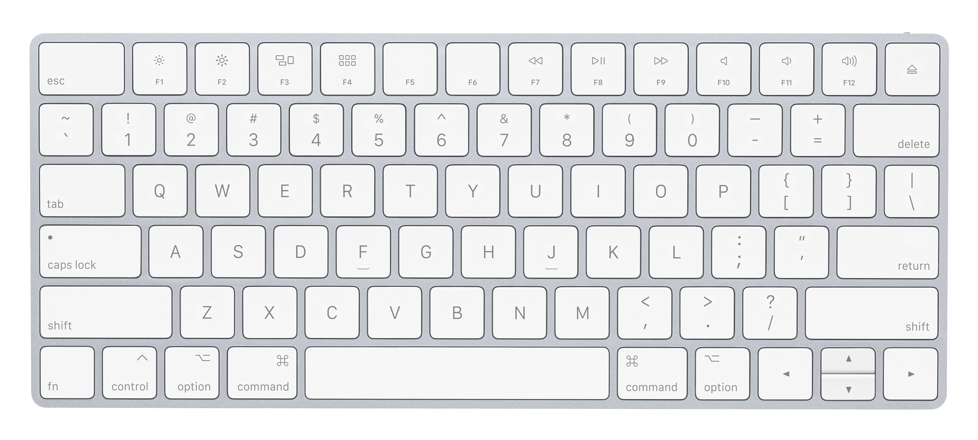
Practice Trials
Ready for some practice trials?
The first half of practice will be slow paced to get you familiarized with the task.
Use your left index finger to press the f key and your right index finger to press the j key during the entire experiment.
Lastly, please maintain fixation throughout the experiment and respond as quickly and as accurately as possible.
Notes:
Write about the red fixation feedback

Slide 9
Good Job! You finished practice.
Now, get ready for the real experiment.
Note: There will be no instructions and the targets will be presented for only a brief period of time.
Press Spacebar to begin the experiment
Notes:
Write about the red fixation feedback

Slide 10
You completed the experiment. Thank you!
Press Spacebar to continue to the survey

